Slide 1
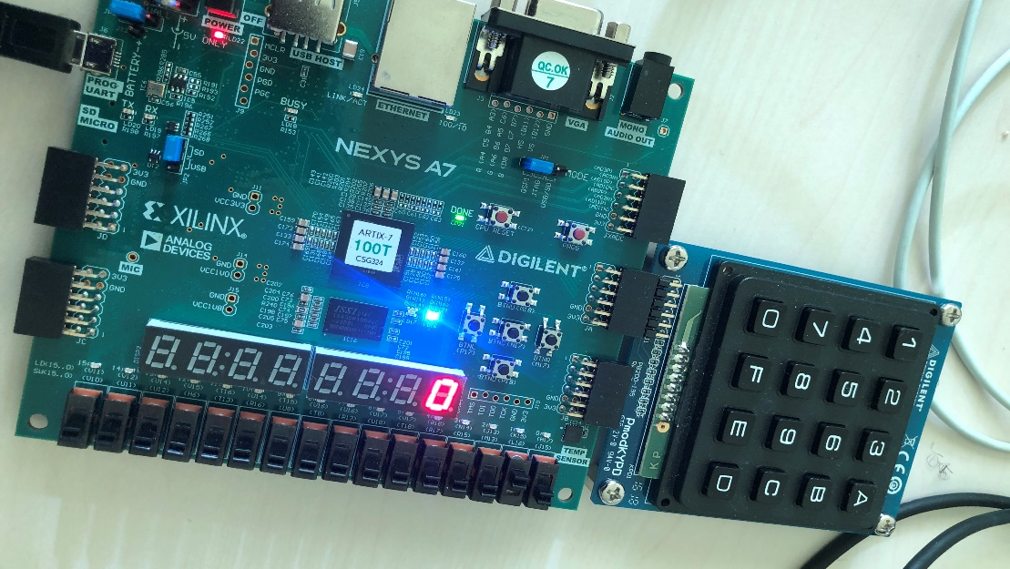
Password Alarm System
Kuye Doluwamu
Ajay Paul
Ashraf Siddiqi Mohammad

Slide 2
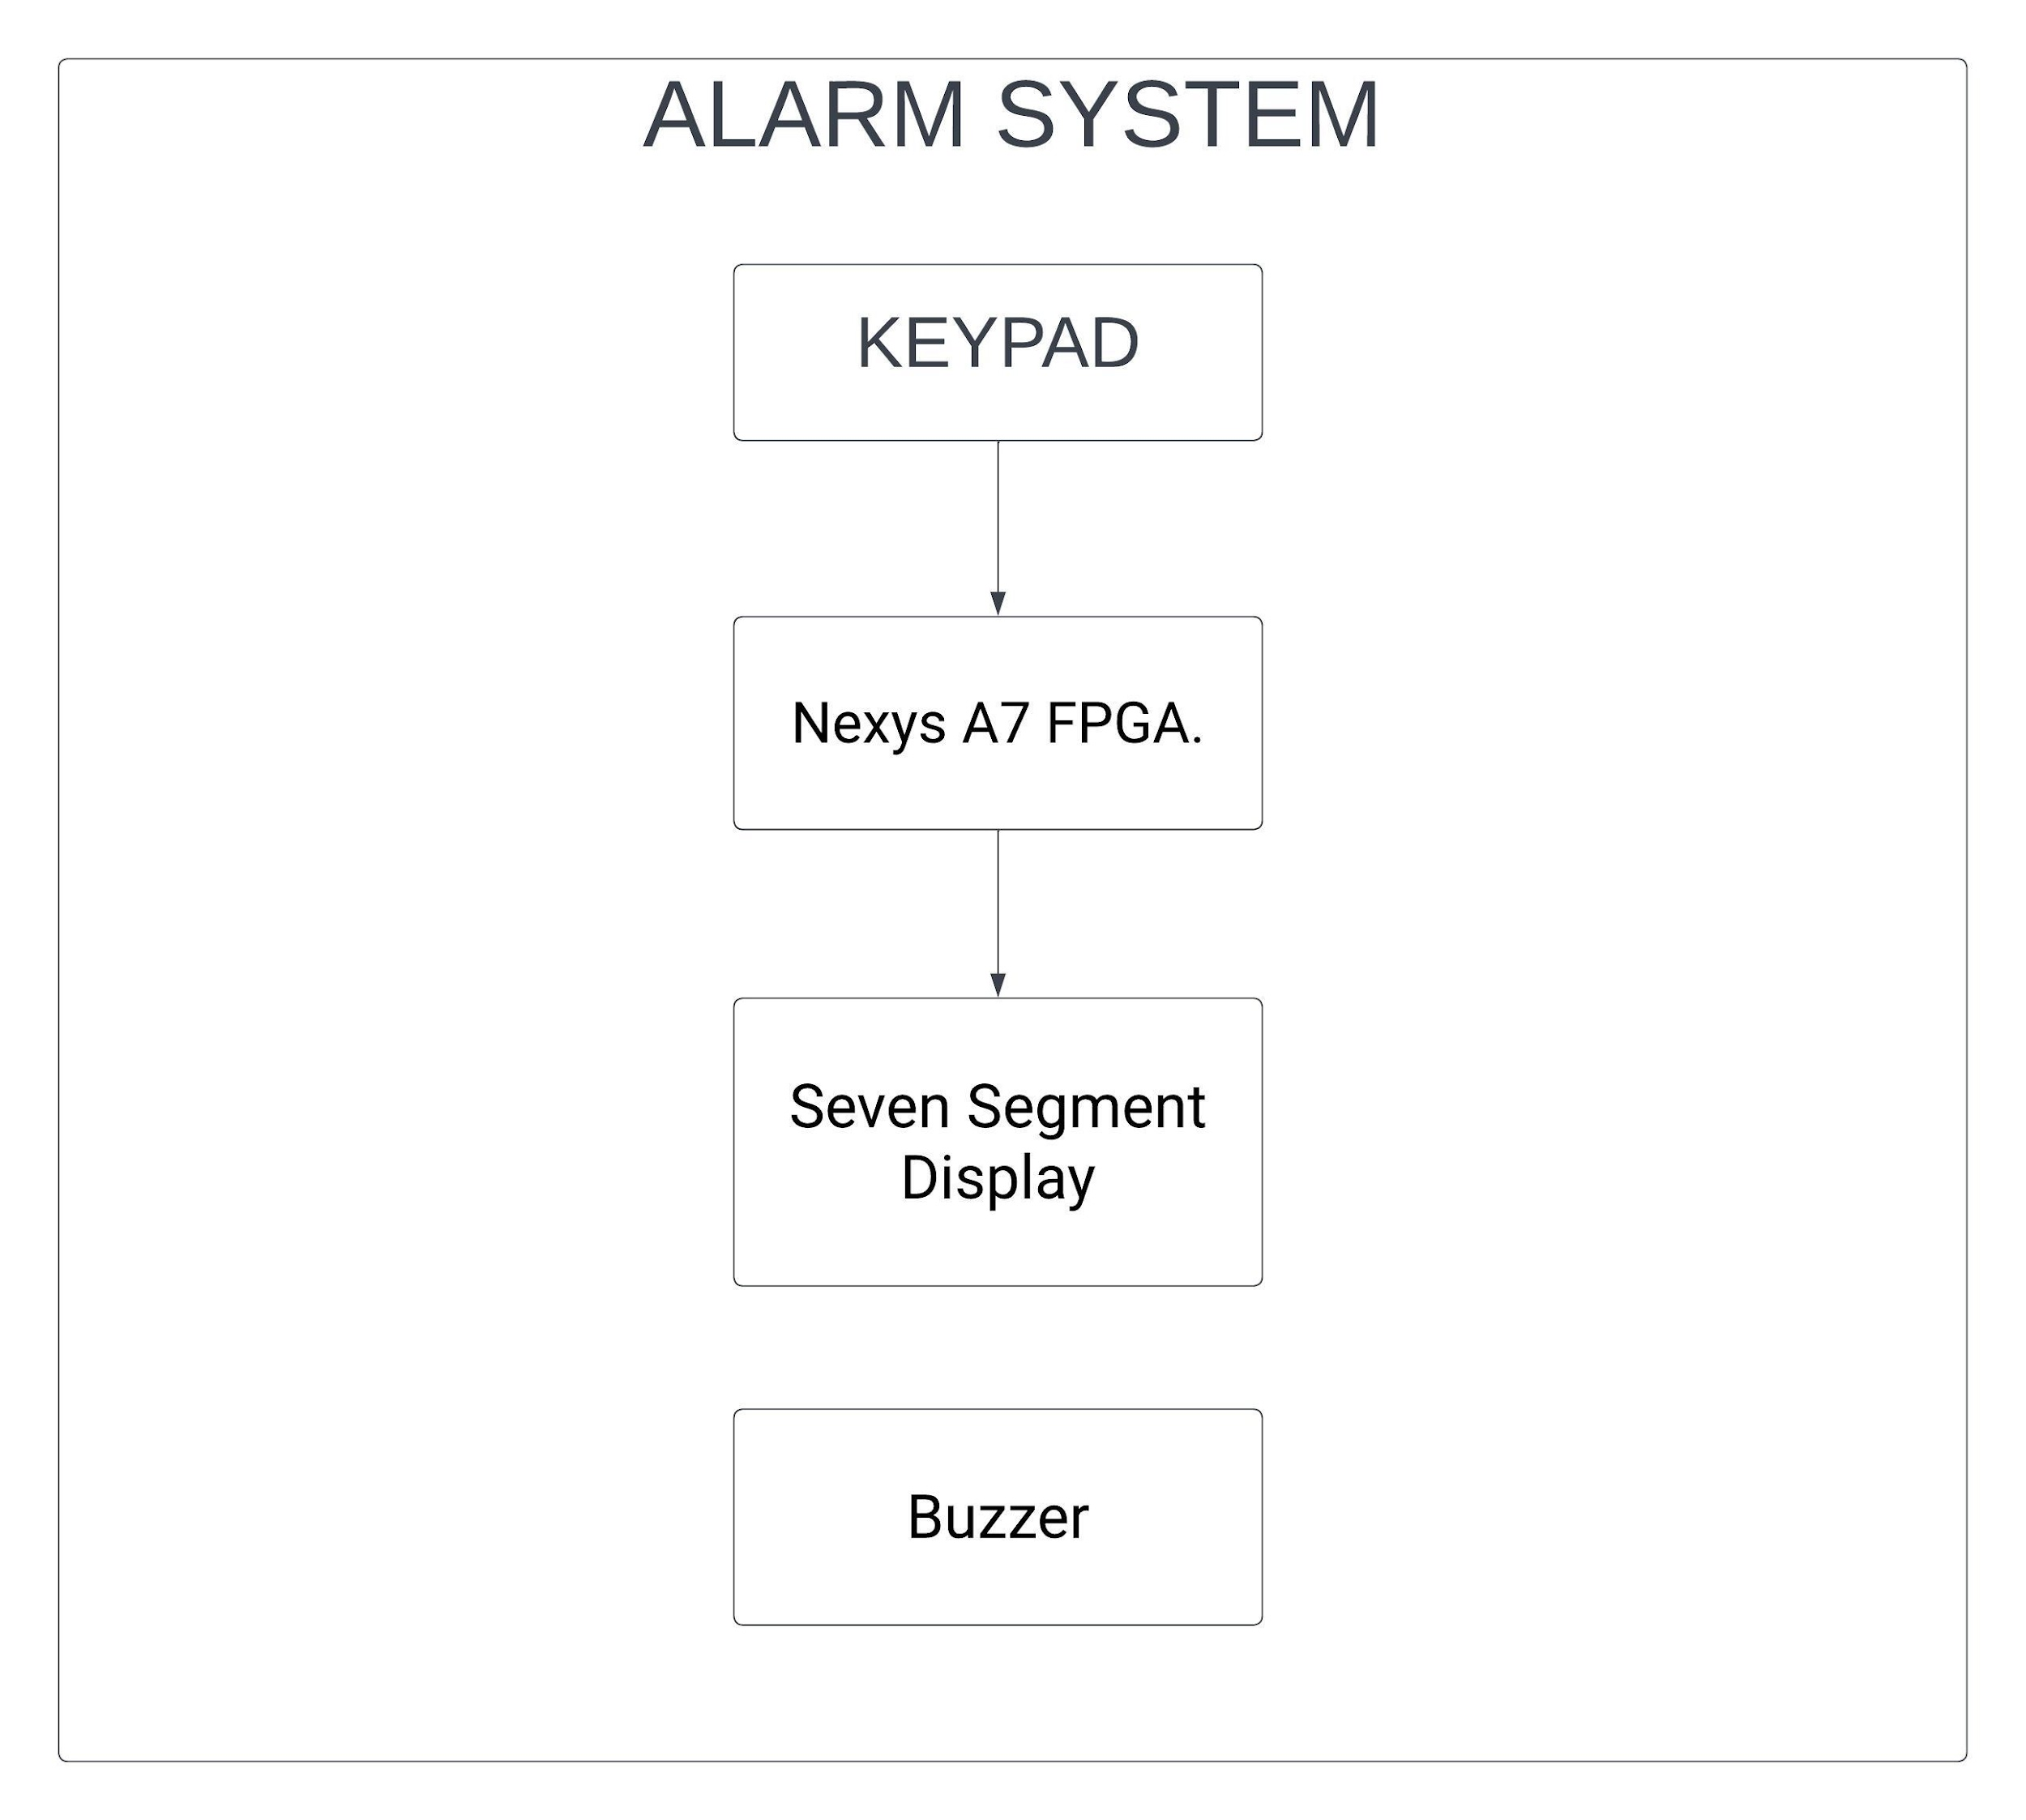
Block Diagram Of the System

Slide 3
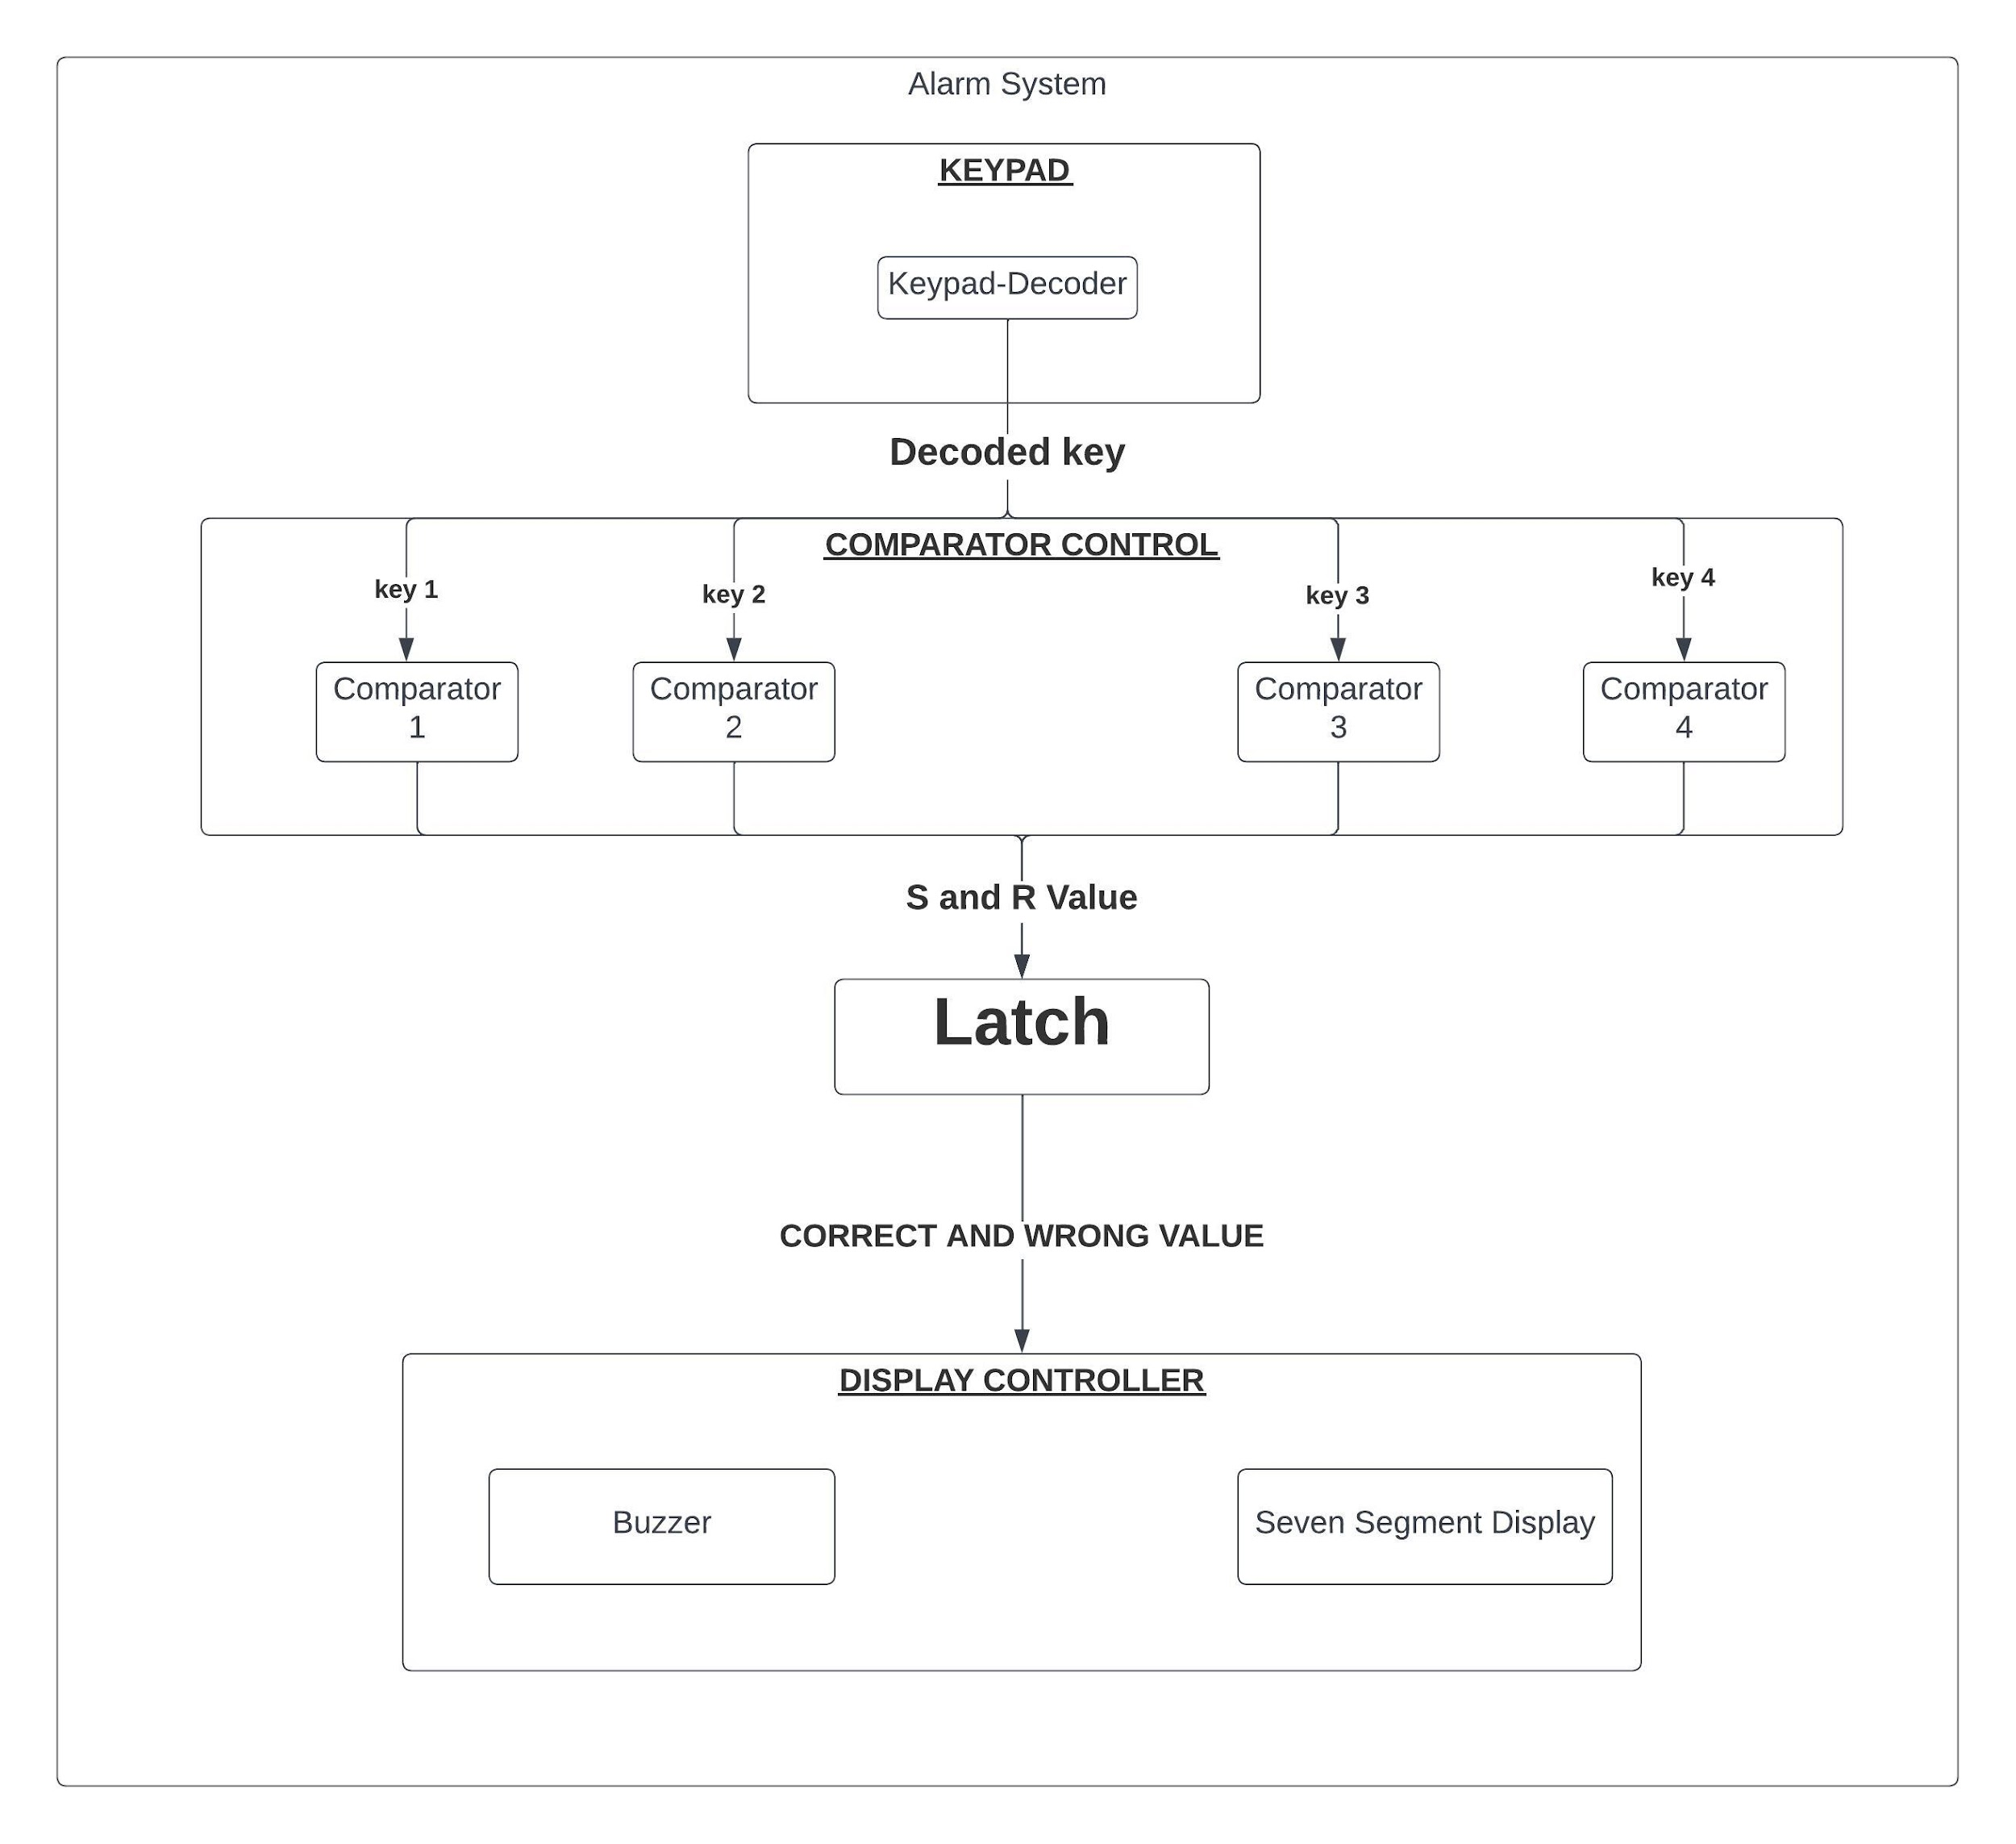
All System Modules

Slide 4
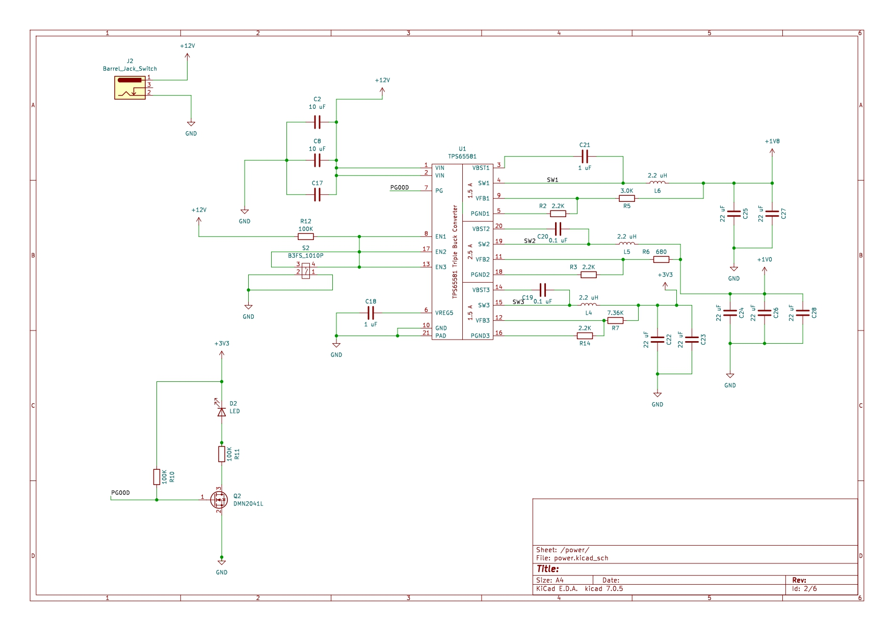
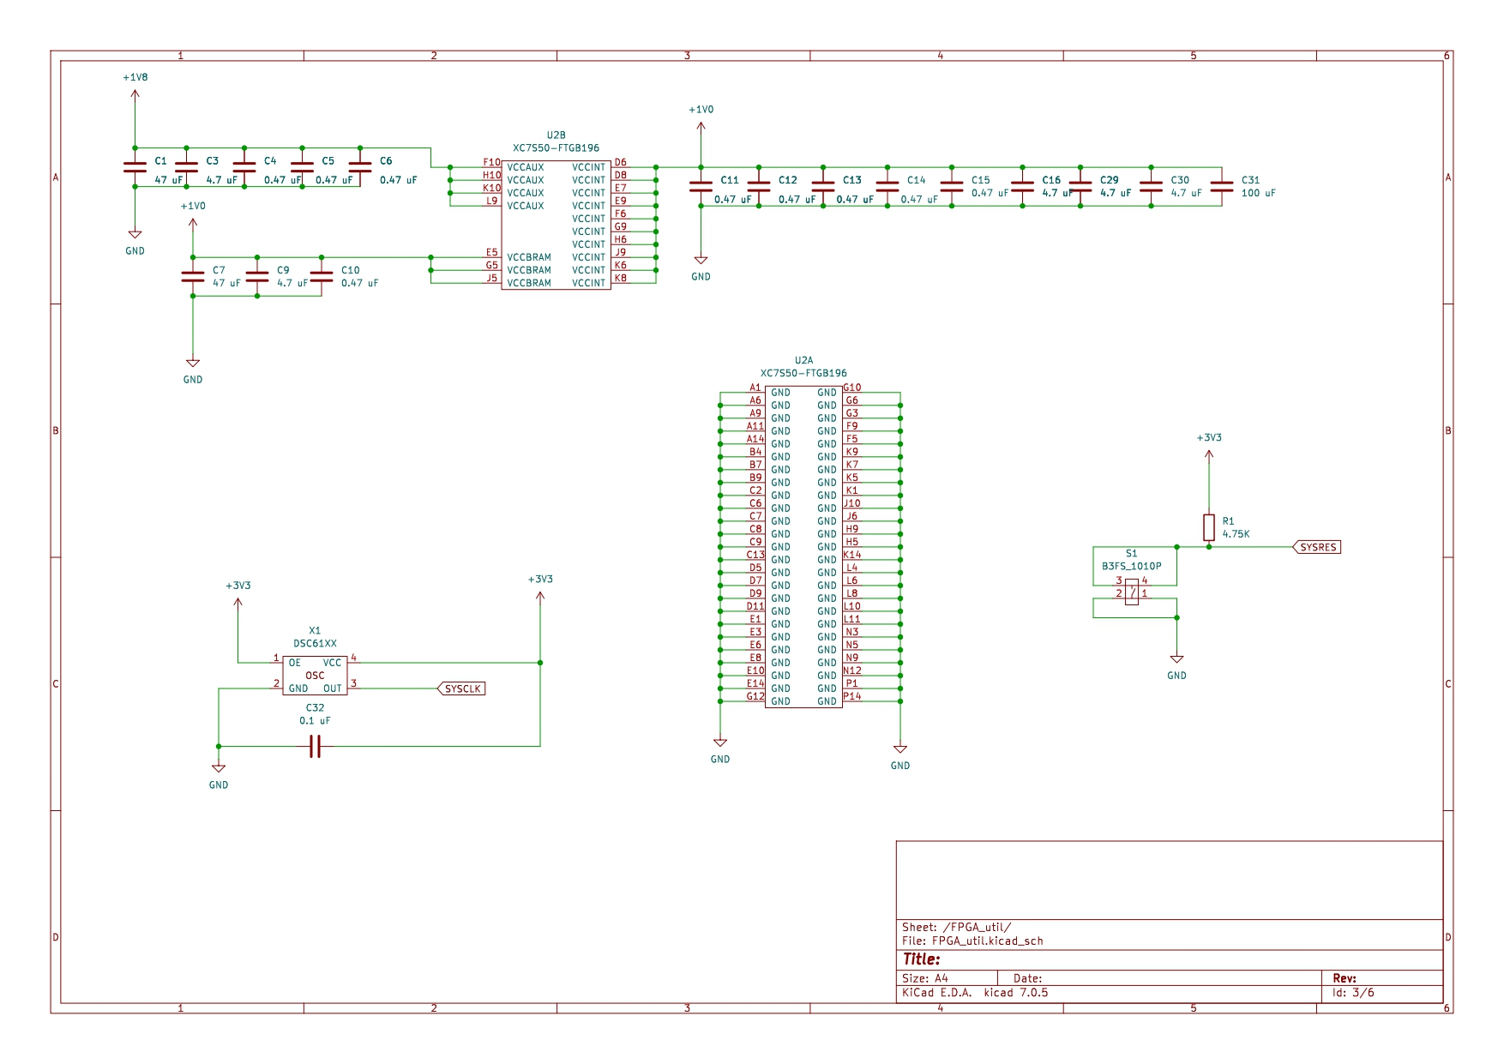
PCB Schematics

Slide 5
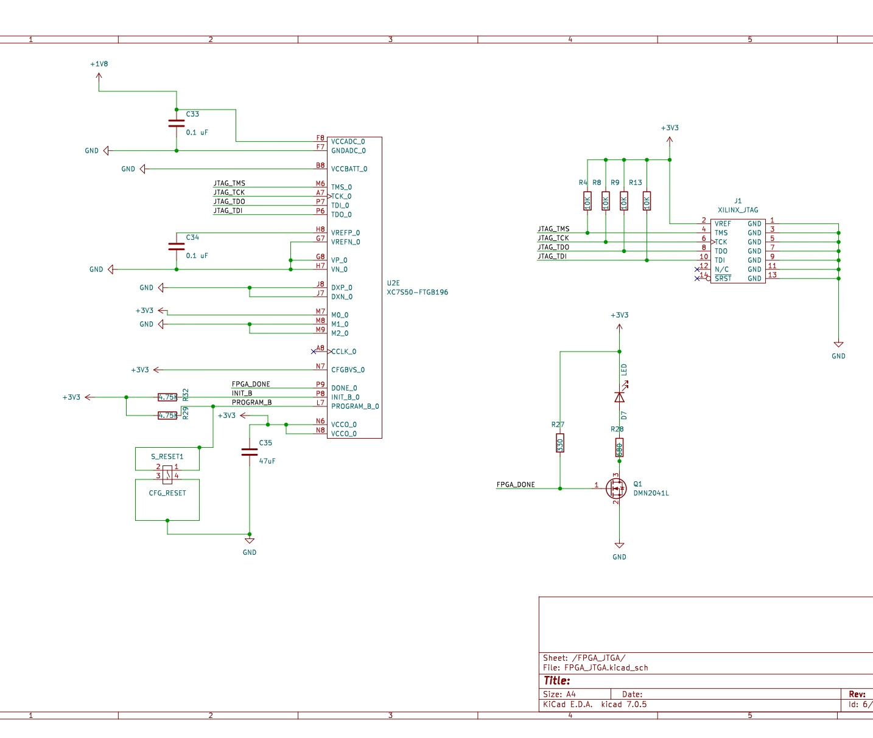
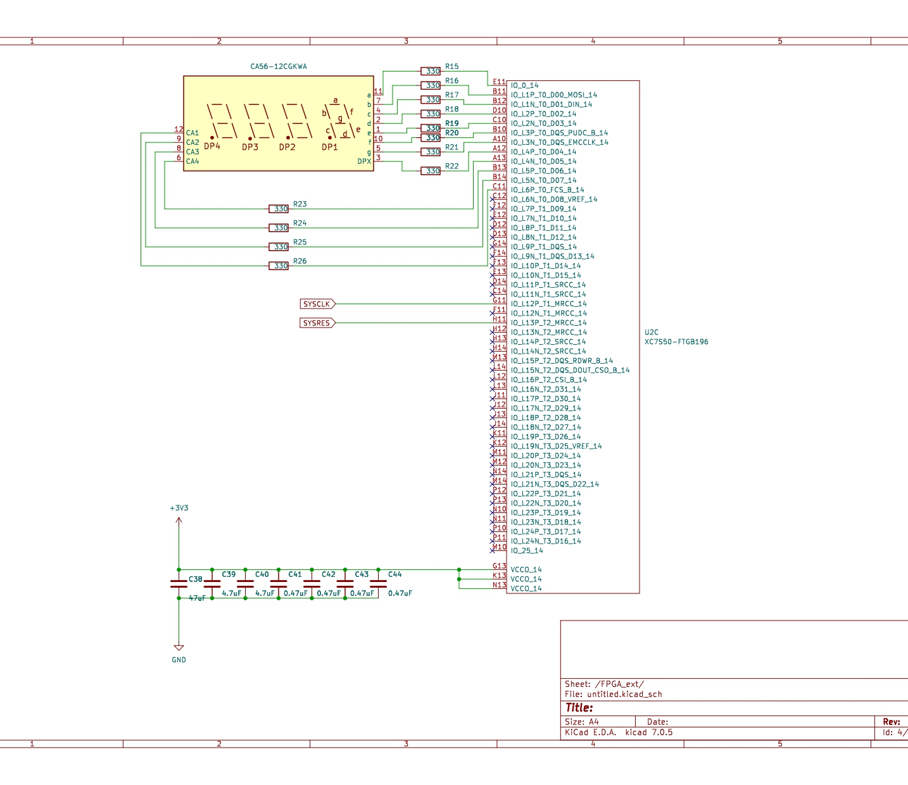
PCB Schematics

Slide 6
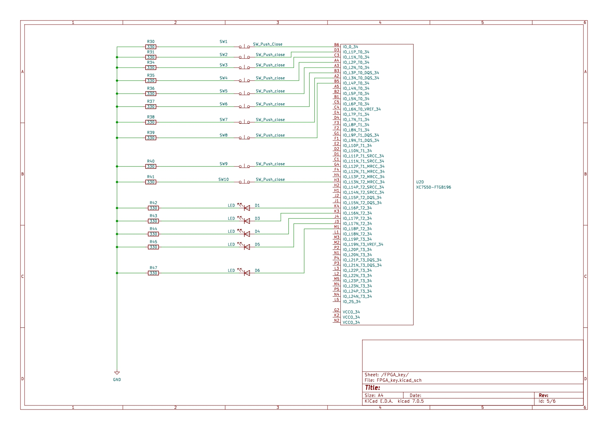
PCB Schematics

Slide 7
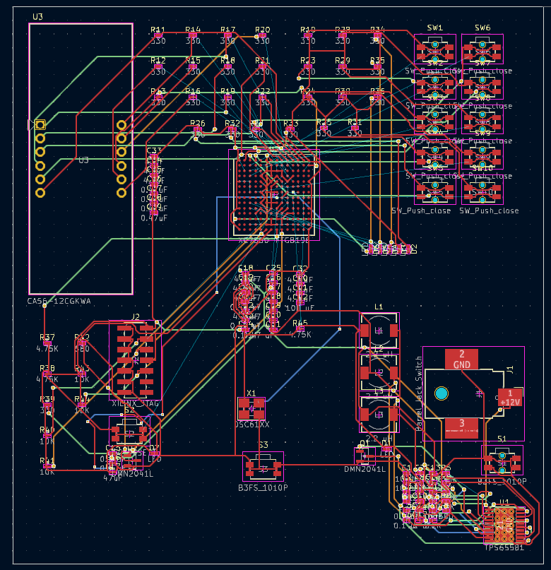
PCB Routing

Slide 8
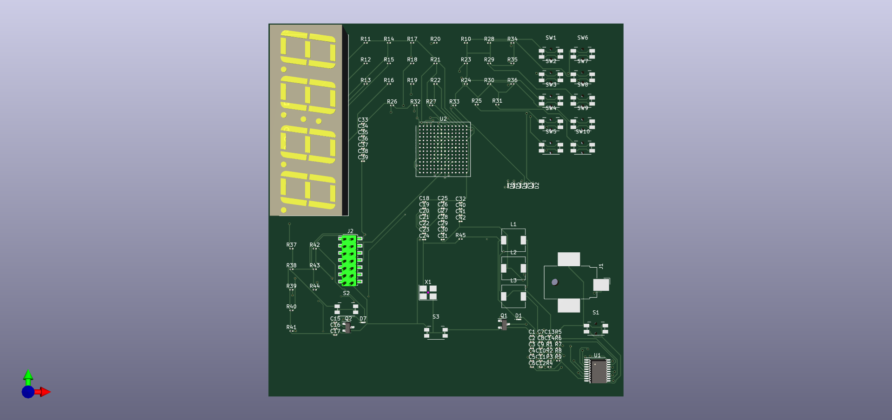
PCB 3D Model

Slide 9
Thank you

